Slide 1

Gesture and Voice Controlled Virtual Mouse
By
Rohit Pancholi, Subroto Saha, Priyal Jangid
(B.Tech 4th Year, Enrollment No.:120002001154, 120002001013, 120002001097 )
Under the Supervision of
Prof. Hriday Banerjee
Dept. of Computer Science & Engineering
University of Engineering & Management, Jaipur

Slide 2
Outlines
Introduction
Literature Review
Objectives
Proposed Model
Experimental Setup
Result Analysis
Conclusion & Future Scope
Reference
Acknowledgement

Slide 3
Introduction
● This project takes forward the approach of the Human Computer Interaction (HCI) by controlling cursor movement through hand movement and voice commands using a real-time camera and microphone.
● Virtual mouse acts as a contactless mouse, thus can be more useful and time saving.
● Specially abled people with some problem in their hands can use this virtual mouse to control the mouse functions in the computer.
● Can be used used for distance controlling of systems in robots, classrooms, war emunisions, AR and VR game, etc.

Slide 4
Literature Review
A literature review on Gesture and Voice Control for Virtual Mouse explores how people can interact with computers without using traditional physical devices like a mouse or keyboard. Instead, users can control the computer using gestures (hand movements) and voice commands. This technology aims to make computer interaction more intuitive and accessible. Researchers investigate the effectiveness, user experience, and challenges associated with implementing gesture and voice control for virtual mice. The review may highlight different methods, technologies, and applications in this field, shedding light on the advancements and potential areas for improvement in making computer interaction more natural and user-friendly.

Slide 5
Objectives
● Design for operation of a mouse with the help of a webcam which is responsible for capturing the video in real-time.
● Convert hand gesture/motion into mouse function and the cursor is set to a particular screen position. The Virtual Mouse application is programmed to detect the position of fingertips and knuckles where it will be set as the position of the mouse pointers.
● Develop a multi user independent speech recognition system that captures voice in real-time with the help of a microphone and is able to retrieve folders, sub-folders, documents, copy, paste, left click, right click and double click by taking voice command and checking its validity.
● Design a voice controlled mouse system that is integrated with the gesture controlled system.

Slide 6
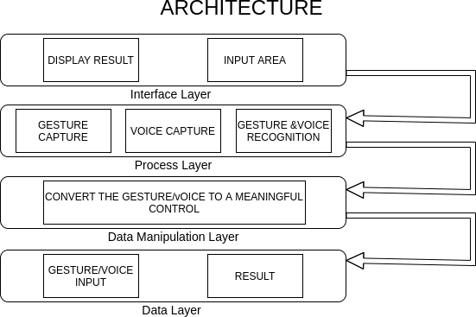
Proposed Model

Slide 7
Experimental Set-up
Camera Placement: Position the camera at an optimal angle and distance to capture the user's hand gestures effectively.
Calibration Process: Implement a calibration step to align the camera view with the virtual space where gestures will be recognized.
Python Script Execution: Develop a main Python script that captures video frames from the camera, processes them using OpenCV for hand tracking, and feeds the data to the gesture recognition algorithm.
Gesture Mapping: Define a set of gestures and map them to specific mouse actions (e.g., move left, move right, click, scroll) within the Python script.
User Interface: Display a simple user interface using a graphical library like Tkinter to showcase the virtual mouse cursor and any relevant information.
Feedback Mechanism: Integrate feedback mechanisms, such as visual indicators or sounds, to notify users when a gesture is recognized and acted upon.
Testing and Refinement: Conduct extensive testing with users, gather feedback, and refine the Python scripts to enhance accuracy and responsiveness.
Power Supply and Connectivity: Ensure the hardware components are adequately powered and establish reliable connections between the Raspberry Pi, camera, and other sensors.

Slide 8
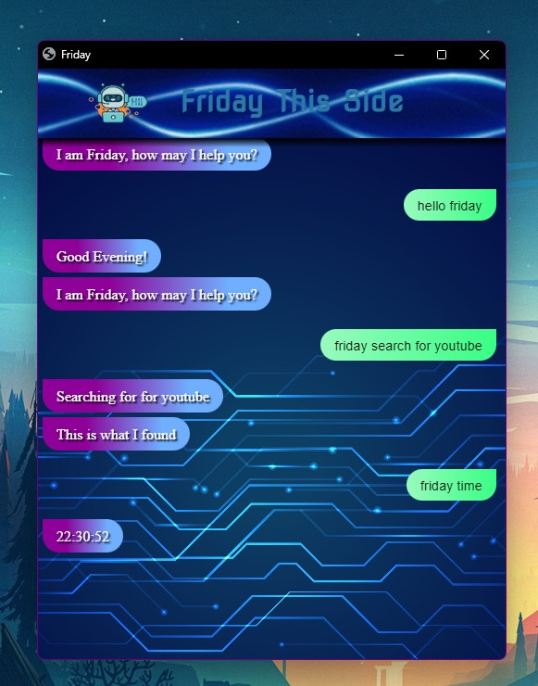
Result: Example

Slide 9
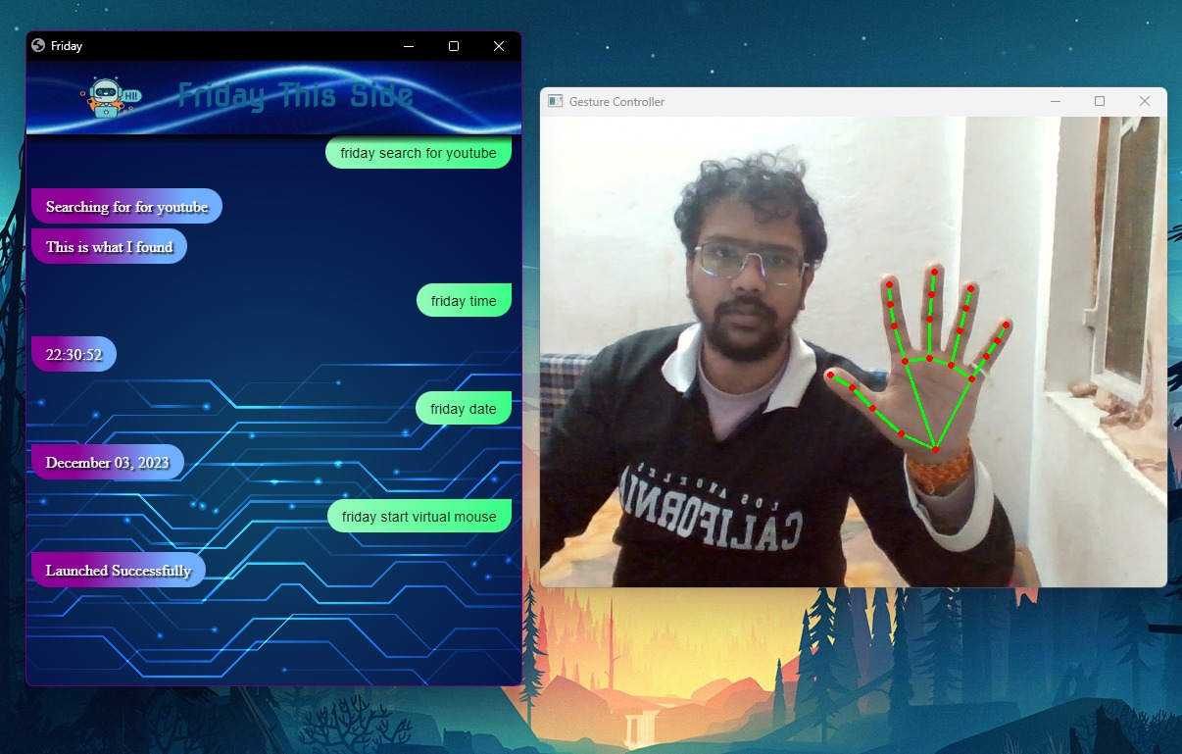

Slide 10
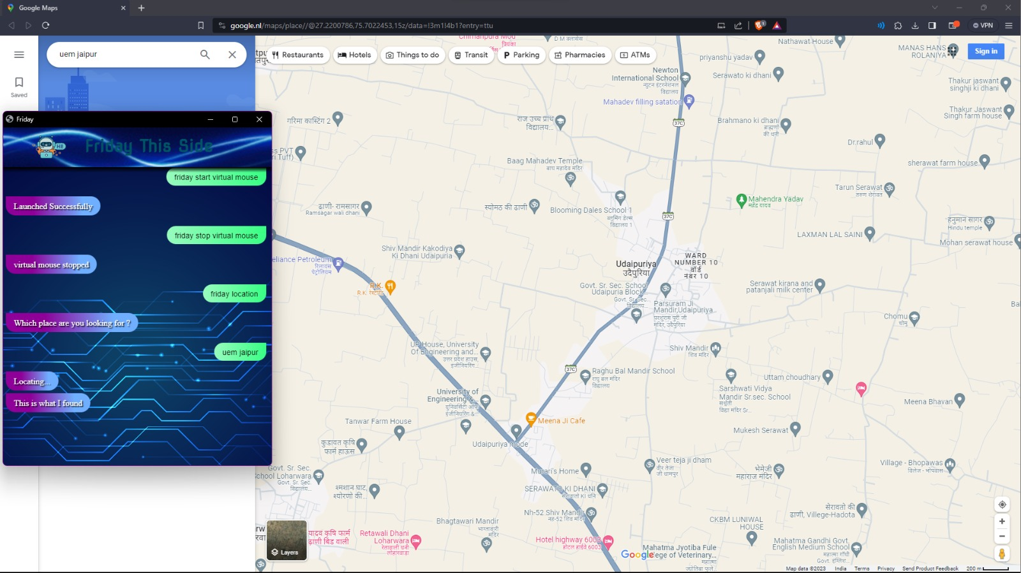

Slide 11
Result Analysis
Result Analysis for Gesture and Voice Control Virtual Mouse Project
Accuracy and Precision:
Gesture Recognition: Evaluate the accuracy of gesture recognition algorithms. Measure precision in capturing and interpreting various hand movements. Analyze the impact of different environmental factors on gesture accuracy.
Voice Recognition: Assess the precision of voice commands and their recognition accuracy. Investigate the influence of background noise on voice control performance. Identify patterns in misrecognition and potential areas for improvement.
2. Efficiency and Task Performance:
Time-Based Metrics: Compare task completion times between traditional mouse input and gesture/voice control. Evaluate the efficiency of each modality for specific tasks (e.g., pointing, clicking, dragging).Examine how users' task performance evolves with prolonged usage.

Slide 12
Limitation
Limited Gesture Vocabulary: Users may find it challenging to remember and execute a large set of gestures, limiting the practicality of extensive gesture-based command systems.
Pace and Environmental Constraints:Gesture control systems often require a certain amount of physical space for accurate tracking. Limited space can restrict the range of gestures a user can perform.External factors such as poor lighting conditions or obstacles in the environment can affect the performance of both gesture and voice control.
Dependency on Hardware:Gesture control often relies on specific hardware, such as depth-sensing cameras or infrared sensors. Users without compatible hardware may be unable to utilize these features

Slide 13
Conclusions & Future Scope
Virtual Mouse will be introduced soon to replace the conventional computer mouse, making it easier for users to connect with and administer their computers. In order to correctly track the user's gesture, the software must be fast enough to capture and process every image and speech command.
The future scope of Gesture and Voice-Controlled Virtual Mouse holds tremendous potential as advancements in technology continue to redefine human-computer interaction. As artificial intelligence and machine learning algorithms evolve, the precision and versatility of gesture and voice recognition are expected to further enhance, offering users even more natural and seamless interactions with digital interfaces.

Slide 14
References
Google: www.google.com
Youtube: www.youtube.com
Wikipedia: www.wikipedia.com

Slide 15
Acknowledgement
The endless thanks goes to Lord Almighty for all the blessings he has showered onto us, which has enabled us to write this last note in our research work. During the period of our research, as in the rest of our life, we have been blessed by Almighty with some extraordinary people who have spun a web of support around us. Words can never be enough in expressing how grateful we to those incredible people in our life who made this thesis possible. We would like an attempt to thank them for making time during our research in the Institute a period We will treasure. We are deeply indebted to our research supervisor, Professor Hriday Banerjee such an interesting thesis topic. Each meeting with him added in valuable aspects to the implementation and broadened us perspective. He has guided us with his invaluable suggestions, lightened up the way in my darkest times and encouraged us a lot in the academic life.
Rohit Pancholi
Subroto Saha
Priyal Jangid

Slide 16

Dept. of CSE, University of Engineering & Management Jaipur

